Slide 1
Vladimir Voevodsky’s
Univalent functions

Slide 2
HISTORICAL ROADMAP
UNDERSTANDING CATEGORY THEORY + USING COMPUTERS TO CHECK MATHEMATICAL REASONING

Slide 3
Vladimir Voevodsky + Michael Kapranov publish “∞-groupoids as a model for a homotopy category”
They claim they have found the connection between ∞-groupoids and homotopy types
‘the intuition appeared that ∞-groupoids should constitute particularly adequate models for homotopy types, the n-groupoids corresponding to truncated homotopy types (with πi = 0 for i > n)’ -- (Grothendieck, Sketch of a program)

Slide 4
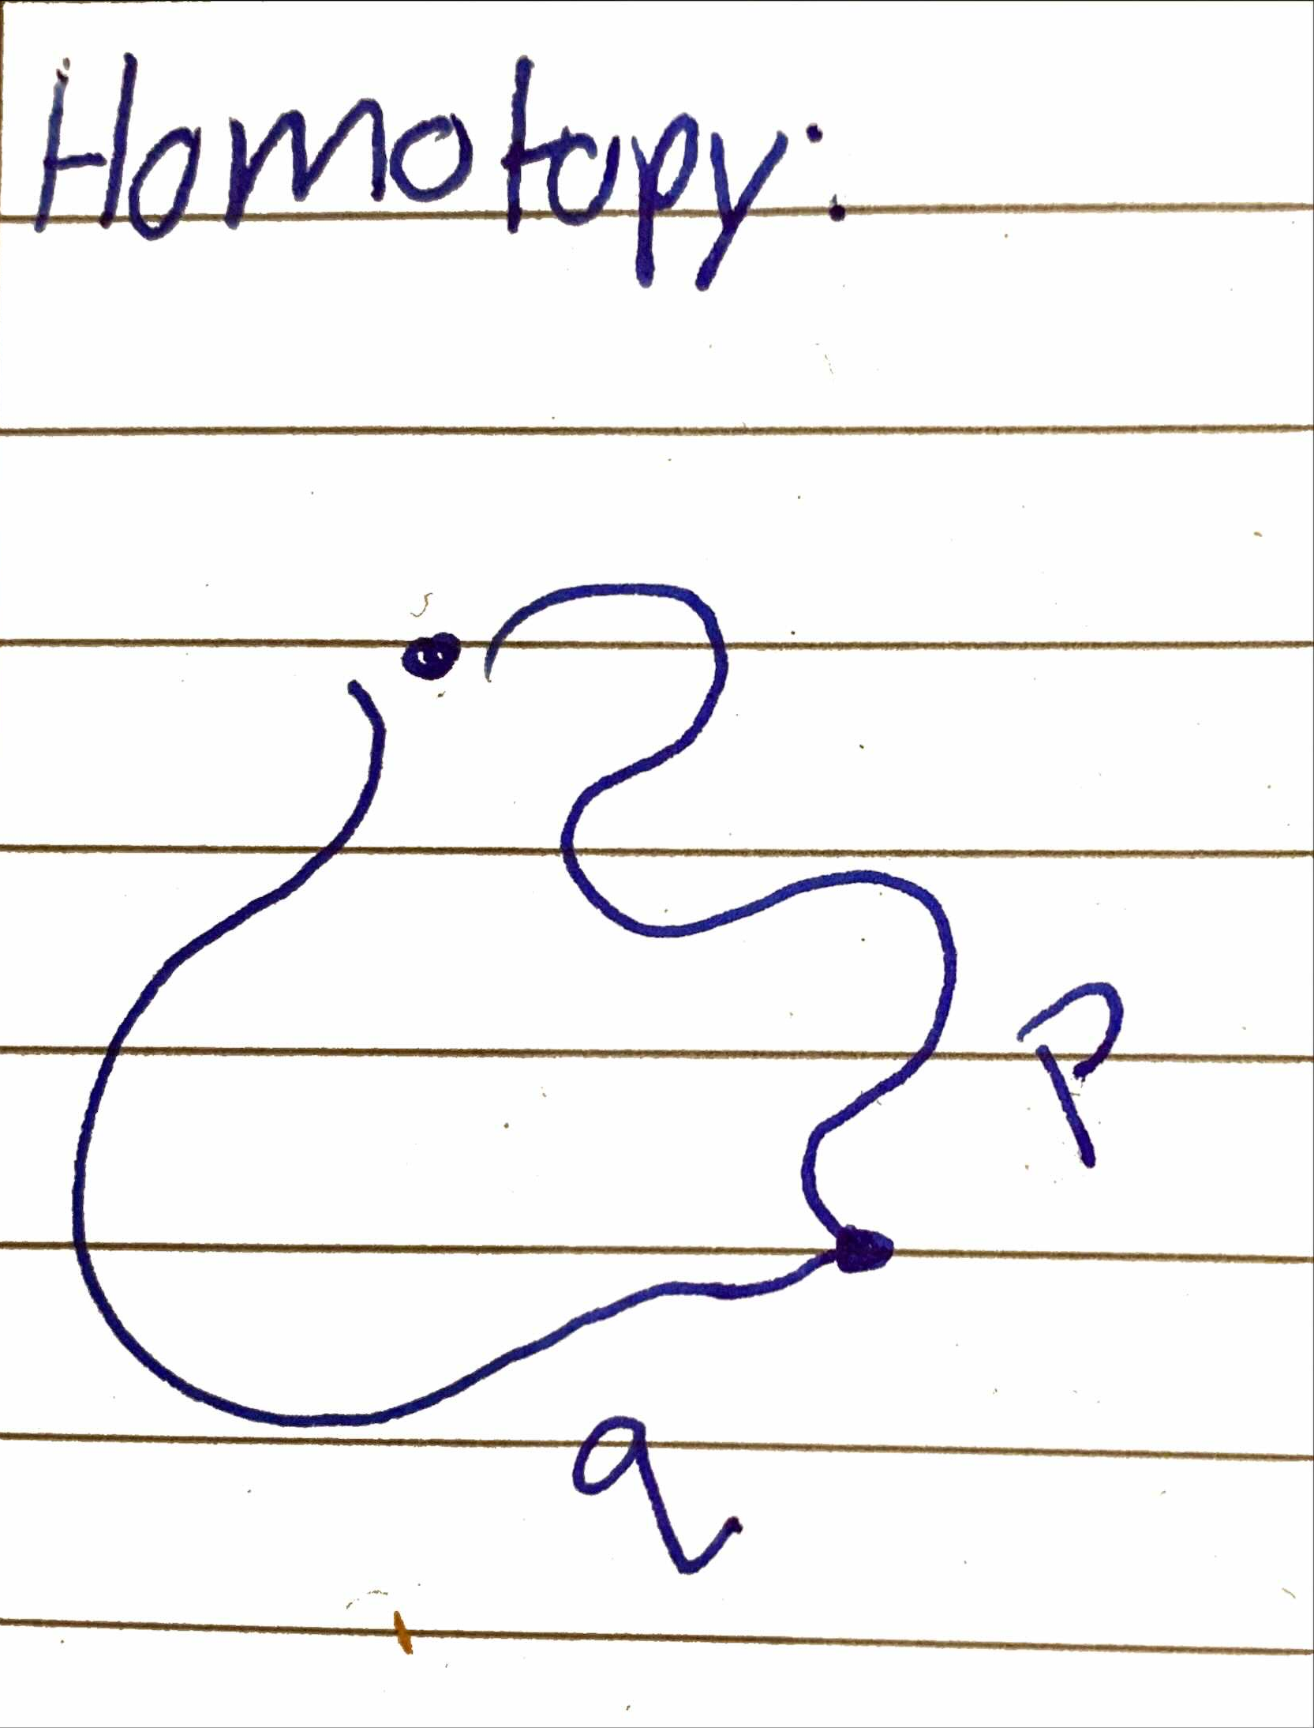
A Brief explanation of homotopy theory
Its a branch of topology that studies space and continuous deformations
Defining a homotopy
  A 2 dimentional path between paths
Defining homotopy theory
  a type of algebraic topology combined with homological algebra that relates to higher category theory

Slide 5
Voevodsky’s program to express mathematics in type theory instead of set theory
This program relies on 2 points:
description of mathematics as analysis of structures on ∞-groupoids
dependent type theory provides a suitable language and system of notations to express structures on ∞-groupoids

Slide 6
What is type theory? In relevance to univalent functions
Its a formal system for constructive mathematics
Its a programming language

Slide 7
Type theory and set theory
Set theory
y∈ B, where y is an element of B
There is a global notions of membership / equality
y as a fixed element of this object
B as an object
Theory in fist order logic
Type theory
x:A , where x has type A
Local typing notions membership replaced ‘is a proof of’
x being a proof of A
A is a statement
we can extend logic to encompass sets

Slide 8
Homotopy types and Sets theory
Martin-Löf type systems
  A new connection between logic and topology
  Formalising levels
Formal proofs in the system as true statements in homotopic theory
Types: A,B, A x B, A ->B
Terms: x:A, b:B, <a,b>
Dependent types: A ⊢ B(x)

Slide 9
Logic in set theory and type theory
Set theory in first order logic
In type theory, logic encompasses sets
  Propositions as types
  AVB, A^B, A=>B
  More than one proof
So, the idea of type theory is to set up a proof system in which can keep track of all logical connectives and them being true or false

Slide 10
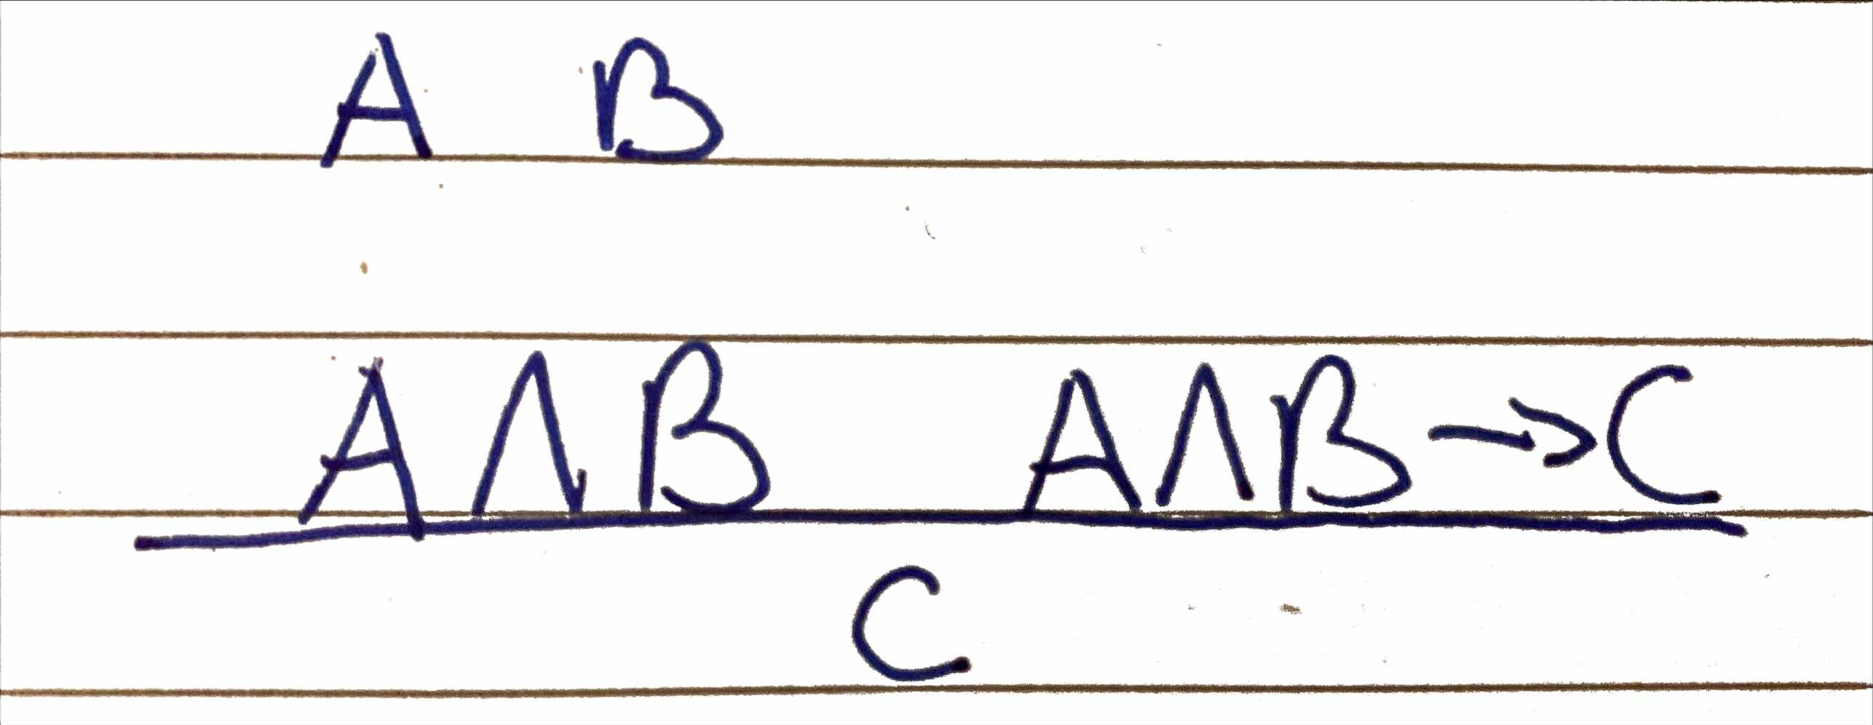
So, we need a formal language to keep track of all these proofs
Language: λ-calculus
Why do we use it?
  Curry-Howard
  Example:

Slide 11
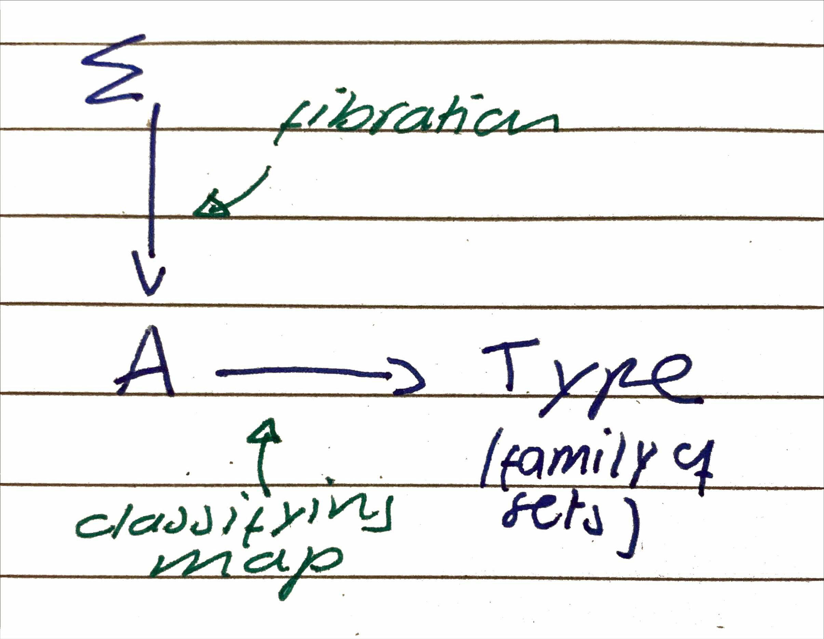
Dependent types
Needed to enrich our language
The dependent map is created when using families of types

Slide 12
This leads to infinity grupoids
Types are not like sets, but like infinity grupoids

Slide 13
Calculus of Inductive Constructions, based on Martin-Löf’s type theory
Amount of types of levels:
  H-Level 0 —there is only one type — this type is one point, its contractible
  H-Level 1 — there is one point and empty set (true values) -- logic
  H-Level 2 — a homotopy type that has a path space between points that is presented as sets
  H-level 3 — homotopy types that have connected components — they are presented as groupoids

Slide 14
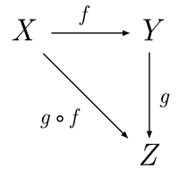
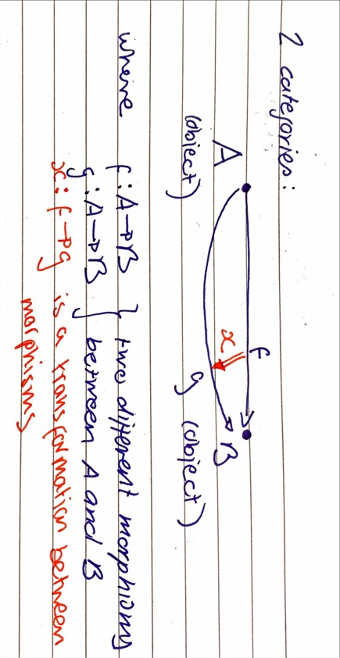
Understanding theory of categories
What is a category?
  Mathematical structures
Objects and morphisms
Properties of categories

Slide 15
PROBLEMS WITH MATHEMATICAL CHECKS as shown by Lemma 1.1 and Carlos Simpson

Slide 16
The problem: Lemma 1.1 as an example
Second example:
Carlos Simpson
“Algebraic Cycles and Higher K-theory” has a mistake in Lemma 1.1
“Cohomological Theory of Presheaves with Transfers” (1992/1993) attempt by V.V
This paper, ironically, also contains a mistake, which is taken care of later on
Carlos Simpson’s“Homotopy types of strict 3-groupoids” (1998)
The paper is not taken into account – why?
  Simpson’s counterexample
  Strong mathematitians

Slide 17
THE NEED FOR A COMPUTER PROOF VERIFICATION

Slide 18
Using computers to check mathematical reasoning
Why?
  who is going to check this advanced + difficult to read paper?
Why was coudnt existing foundational systems inneficient?
  Need to use of formal language
  Language is too limited
This created the need for a new foundation
  diversion from ZFC and category theory

Slide 19
Understanding the Zermelo-Fraenkel theory with the Axiom of Choice
ZFC:
  1. Learn predicate logic
  2. Lear a particular theory of this logic (the ZFC)
  3. Translate propositions of mathematical concepts to formulas of ZFC
  4. Prove using examples that these mathematics are reduced to these basic
This was reliable/consistent, but obviously not complete

Slide 20
Univalent foundations – a complete foundational system
What shows that a foundation for mathematics is complete:
  a formal deduction system
  structure that provides meaning to humans
  Structure allows humans to encode mathematics in terms associated to the language a computer understands
All of these components are in:
  ZFC
  Univalent functions
  How are they different?

Slide 21
Functions of the univalent foundations of mathematics
Can be used for constructive + nonconstructive thematics
Based on direct formalisation/axiomatisation of the world of homotopy types instead of the world of sets

Slide 22
Conclusion
The development of univalent foundations comes from the need of a foundation that both satisfies the needs of human mathematical practice and computer formalization
Use of proof assessment:
  every conclusion reached by a mathematician is sure to be right + doesn't have to be double-checked
  no need to stress about complicated arguments, as we can always trust the computer

